Slide 1
Βασιλική Καλοδήμου Εθνικό Σημείο Επαφής για το πρόγραμμα «Ορίζοντας Ευρώπη» Τεχνικό Επιμελητήριο Ελλάδας, 13.07.2023
Κριτήρια αξιολόγησης στον Ορίζοντα Ευρώπη

Slide 2
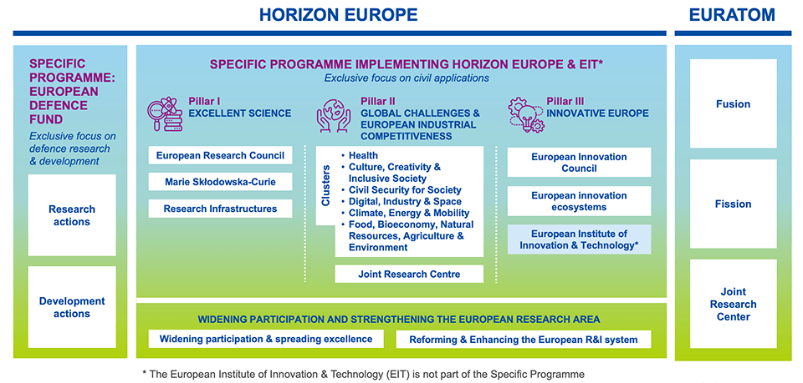
Which programme part are you for?

Slide 3
Statistics

Slide 4
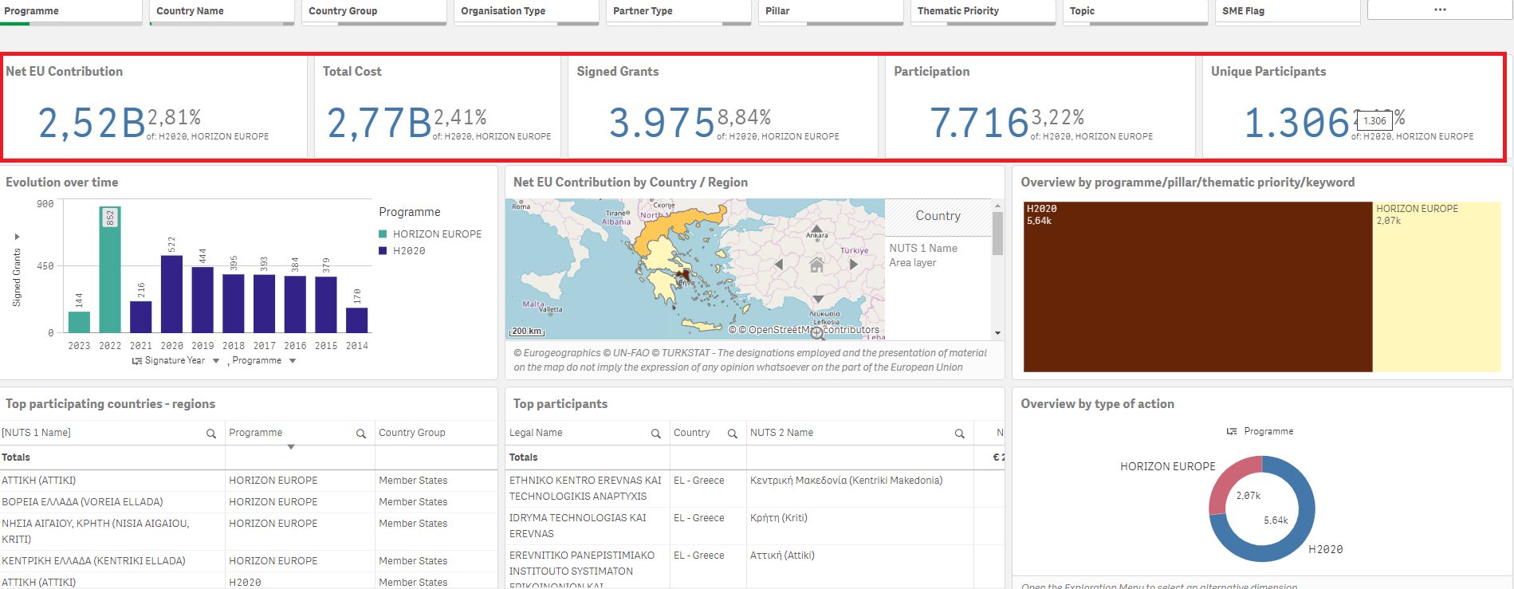
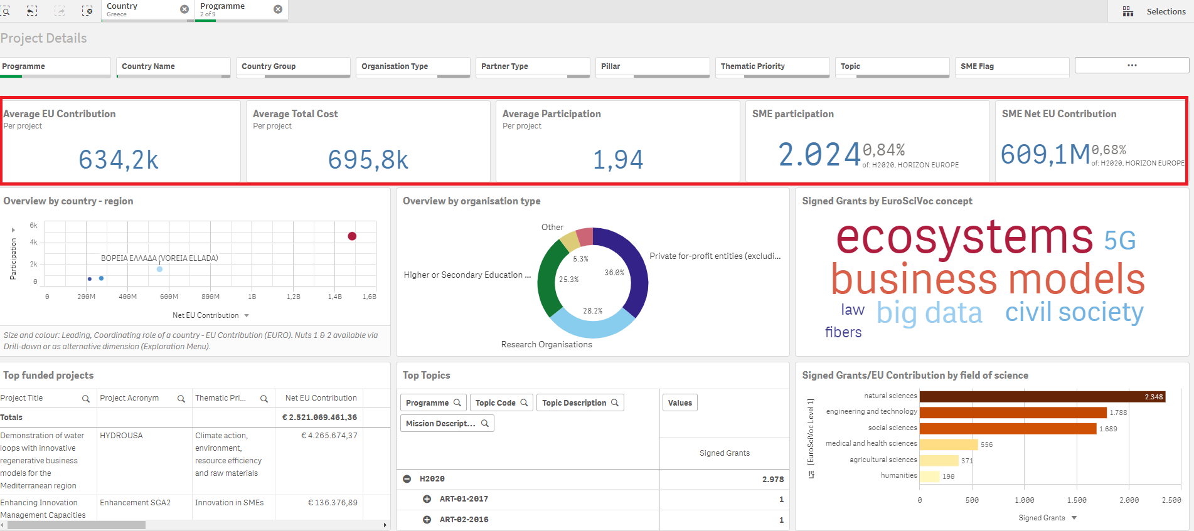
Συμμετοχή ελληνικών φορέων - SMEs

Slide 5
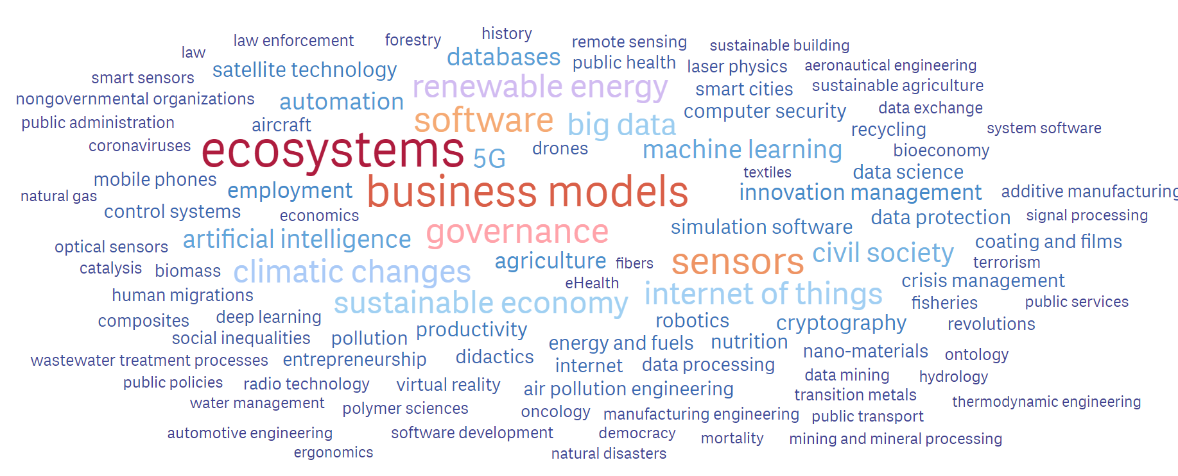
Συμμετοχή ελληνικών φορέων - SMEs

Slide 6
Type of actions
Research and innovation action (RIA)
Activities to establish new knowledge or to explore the feasibility of a new or improved technology, product, process, service or solution.
100% funding rate
Innovation action (IA)
Activities to produce plans and arrangements or designs for new, altered or improved products, processes or services.
70% funding rate for profit-making entities
Coordination and support actions (CSA)
Activities that contribute to the objectives of Horizon Europe. This excludes R&I activities, except for ‘Widening participation and spreading excellence’
100% funding rate
Notes:
Δράσεις έρευνας και καινοτομίας Χρηματοδότηση ερευνητικών προγραμμάτων που αντιμετωπίζουν σαφώς καθορισμένες προκλήσεις και τα οποία μπορούν να οδηγήσουν στην ανάπτυξη νέας γνώσης ή νέας τεχνολογίας. Ποιοι μπορούν να συμμετάσχουν; Κοινοπραξίες εταίρων από διαφορετικές χώρες, που μπορεί να ανήκουν σε διαφορετικό κλάδο ή ακαδημαϊκό κύκλο.
Δράσεις καινοτομίας Η χρηματοδότηση εστιάζει περισσότερο σε δραστηριότητες που βρίσκονται πιο κοντά στην αγορά. Παραδείγματος χάριν, κατασκευή πρωτοτύπων, διεξαγωγή δοκιμών, παρουσίαση, πιλοτικές εφαρμογές, κλιμάκωση κ.τ.λ., εάν στοχεύουν στην παραγωγή νέων ή βελτιωμένων προϊόντων ή υπηρεσιών. Ποιοι μπορούν να συμμετάσχουν; Κοινοπραξίες εταίρων από διαφορετικές χώρες, που μπορεί να ανήκουν σε διαφορετικό κλάδο ή ακαδημαϊκό κύκλο. 70% (except for non-profit legal entities, where a rate of up to 100% applies)
Συντονισμός και δράσεις στήριξης Η χρηματοδότηση καλύπτει τον συντονισμό και τη δικτύωση έργων, προγραμμάτων και πολιτικών έρευνας και καινοτομίας. Η χρηματοδότηση για την έρευνα και την καινοτομία αυτή καθαυτή καλύπτεται από άλλη συνιστώσα. Ποιοι μπορούν να συμμετάσχουν; Μεμονωμένοι φορείς ή κοινοπραξίες εταίρων από διαφορετικές χώρες, που μπορεί να ανήκουν σε διαφορετικό κλάδο ή ακαδημαϊκό κύκλο.

Slide 7
Evaluation Criteria

Slide 8
Horizon Europe: Proposal evaluation
Excellence
Clarity and pertinence of the project’s objectives, and the extent to which the proposed work is ambitious, and goes beyond the state-of-the-art.
Soundness of the proposed methodology, including the underlying concepts, models, assumptions, inter-disciplinary approaches, appropriate consideration of the gender dimension in research and innovation content, and the quality of open science practices including sharing and management of research outputs and engagement of citizens, civil society and end users where appropriate.
IMPACT
Credibility of the pathways to achieve the expected outcomes and impacts specified in the work programme, and the likely scale and significance of the contributions due to the project.
Suitability and quality of the measures to maximize expected outcomes and impacts, as set out in the dissemination and exploitation plan, including communication activities.
Quality and efficiency of the implementation
Quality and effectiveness of the work plan, assessment of risks, and appropriateness of the effort assigned to work packages, and the resources overall.
Capacity and role of each participant, and extent to which the consortium as a whole brings together the necessary expertise.
Notes:
Σε περίπτωση ισοβαθμίας των προτάσεων, θα γίνει επιλογή βάσει κριτηρίων όπως αριθμός γυναικών στην πρόταση και η γεωγραφική κάλυψη των δράσεων
Proposals that address call aspects identified in the topic description not otherwise covered by more
highly ranked proposals, will be considered to have the highest priority.
The proposals identified under 1), if any, will themselves be prioritised according to the scores they have been awarded for the criterion ‘Excellence’. When these scores are equal, priority will be based on scores for the criterion ‘Impact ’. NB: In the case of Innovation actions this prioritisation will be done first on the basis of the score for ‘Impact’, and then on that for ‘Excellence’.
If necessary, the gender balance among the personnel named in the proposal who will be primarily responsible for carrying out the research and/or innovation activities, and who are included in the researchers table of the proposal, will be used as a factor for prioritisation.
If necessary, any further prioritisation will be based on geographical diversity, defined as the number of EU Member states or Associated Countries represented in the proposal, not otherwise receiving funds from projects higher up the ranking list (and if equal in number, then by budget).
If a distinction still cannot be made, the panel may decide to further prioritise by considering other factors related to the objectives of the call, or to Horizon Europe in general. These may include, for example, enhancing the quality of the project portfolio through synergies between projects or, where relevant and feasible, involvement of SMEs. These factors will be documented in the panel report.

Slide 9
Βασική στοιχεία στη συγγραφή πρότασης

Slide 10

Produce a concept note (initial outline of your idea)
Write preliminary 2-3 pages about your:
objectives
European relevance (topic, WP, Horizon EU strategic plan, EU priorities)
target groups
Impact envisaged
Methodology to be followed
major steps (work packages)
Performance measurements (KPIs)
Type of expertise needed: intended consortium (countries, types of organisations)

Slide 11
Basic roles in a proposal…
Coordinator
Work Package leaders
Task leaders
Contributors

Slide 12
Excellence: Evaluation Criteria
Excellence
Clarity and pertinence of the project’s objectives, and the extent to which the proposed work is ambitious, and goes beyond the state-of-the-art.
Soundness of the proposed methodology, including the underlying concepts, models, assumptions, inter-disciplinary approaches, appropriate consideration of the gender dimension in research and innovation content, and the quality of open science practices including sharing and management of research outputs and engagement of citizens, civil society and end users where appropriate.
IMPACT
Credibility of the pathways to achieve the expected outcomes and impacts specified in the work programme, and the likely scale and significance of the contributions due to the project.
Suitability and quality of the measures to maximize expected outcomes and impacts, as set out in the dissemination and exploitation plan, including communication activities.
Quality and efficiency of the implementation
Quality and effectiveness of the work plan, assessment of risks, and appropriateness of the effort assigned to work packages, and the resources overall.
Capacity and role of each participant, and extent to which the consortium as a whole brings together the necessary expertise.
Notes:
Σε περίπτωση ισοβαθμίας των προτάσεων, θα γίνει επιλογή βάσει κριτηρίων όπως αριθμός γυναικών στην πρόταση και η γεωγραφική κάλυψη των δράσεων
Proposals that address call aspects identified in the topic description not otherwise covered by more
highly ranked proposals, will be considered to have the highest priority.
The proposals identified under 1), if any, will themselves be prioritised according to the scores they have been awarded for the criterion ‘Excellence’. When these scores are equal, priority will be based on scores for the criterion ‘Impact ’. NB: In the case of Innovation actions this prioritisation will be done first on the basis of the score for ‘Impact’, and then on that for ‘Excellence’.
If necessary, the gender balance among the personnel named in the proposal who will be primarily responsible for carrying out the research and/or innovation activities, and who are included in the researchers table of the proposal, will be used as a factor for prioritisation.
If necessary, any further prioritisation will be based on geographical diversity, defined as the number of EU Member states or Associated Countries represented in the proposal, not otherwise receiving funds from projects higher up the ranking list (and if equal in number, then by budget).
If a distinction still cannot be made, the panel may decide to further prioritise by considering other factors related to the objectives of the call, or to Horizon Europe in general. These may include, for example, enhancing the quality of the project portfolio through synergies between projects or, where relevant and feasible, involvement of SMEs. These factors will be documented in the panel report.

Slide 13
Excellence
1.1 Objectives
1.2 Relation to the work programme
1.3 Concept and approach
1.4 Ambition
1.5 Gender dimension
1.6 Open science
1.7 No harm principle
1.8 Data management
Notes:
How will this data be exploited and/or shared/made accessible for verification and re-use? If data cannot be made available, explain why.

Slide 14
Objectives
“Describe the overall and specific objectives for the project, which should be clear, measurable, realistic and achievable within the duration of the project. Objectives should be consistent with the expected exploitation and impact of the project (see section 2).”
Objectives should be translated into WPs, and actionable tasks

Slide 15
Objectives - examples
REHOUSE proposes solutions that cover together a set of 5 renovation
principles offering technically and economically affordable renovation solutions
with enough flexibility to tackle almost 100 % of the building renovation
challenges at EU level.
APPRAISE aims to build on the latest advances in big data analysis, artificial
intelligence, and advanced visualisation to create an integral security framework
that will improve both the cyber/physical security and safety of public spaces by
enabling a proactive, integrated, risk-based, and resilience-oriented approach
BIOCON-CO₂ aims to develop and validate a platform of flexible and versatile
techniques capable of using biological processes to transform raw CO₂ waste
from the iron, steel, cement and electric power industries into value-added
chemicals and plastics.

Slide 16
Relation to the work progamme, Methodology, Ambition
Dismantle the Work proramme (decode it)
Make a table of each element in the call text and correlate it with your proposal (objectives, tasks)
CONCEPT & METHODOLOGY
Which models, which hypothesis and assumptions
Technology readiness level (TRL)
Relevance to society, gender dimension
AMBITION
What is the state of the art (technologies AND projects already funded), how do you go beyond state of art? What is ground breaking about your idea?
Freedom to operate?

Slide 17
Horizon Europe: Proposal evaluation
Excellence
Clarity and pertinence of the project’s objectives, and the extent to which the proposed work is ambitious, and goes beyond the state-of-the-art.
Soundness of the proposed methodology, including the underlying concepts, models, assumptions, inter-disciplinary approaches, appropriate consideration of the gender dimension in research and innovation content, and the quality of open science practices including sharing and management of research outputs and engagement of citizens, civil society and end users where appropriate.
IMPACT
Credibility of the pathways to achieve the expected outcomes and impacts specified in the work programme, and the likely scale and significance of the contributions due to the project.
Suitability and quality of the measures to maximize expected outcomes and impacts, as set out in the dissemination and exploitation plan, including communication activities.
Quality and efficiency of the implementation
Quality and effectiveness of the work plan, assessment of risks, and appropriateness of the effort assigned to work packages, and the resources overall.
Capacity and role of each participant, and extent to which the consortium as a whole brings together the necessary expertise.
Notes:
Σε περίπτωση ισοβαθμίας των προτάσεων, θα γίνει επιλογή βάσει κριτηρίων όπως αριθμός γυναικών στην πρόταση και η γεωγραφική κάλυψη των δράσεων
Proposals that address call aspects identified in the topic description not otherwise covered by more
highly ranked proposals, will be considered to have the highest priority.
The proposals identified under 1), if any, will themselves be prioritised according to the scores they have been awarded for the criterion ‘Excellence’. When these scores are equal, priority will be based on scores for the criterion ‘Impact ’. NB: In the case of Innovation actions this prioritisation will be done first on the basis of the score for ‘Impact’, and then on that for ‘Excellence’.
If necessary, the gender balance among the personnel named in the proposal who will be primarily responsible for carrying out the research and/or innovation activities, and who are included in the researchers table of the proposal, will be used as a factor for prioritisation.
If necessary, any further prioritisation will be based on geographical diversity, defined as the number of EU Member states or Associated Countries represented in the proposal, not otherwise receiving funds from projects higher up the ranking list (and if equal in number, then by budget).
If a distinction still cannot be made, the panel may decide to further prioritise by considering other factors related to the objectives of the call, or to Horizon Europe in general. These may include, for example, enhancing the quality of the project portfolio through synergies between projects or, where relevant and feasible, involvement of SMEs. These factors will be documented in the panel report.

Slide 18
Impact: Go beyond
2.1 Project’s pathways towards impact
2.2 Measures to maximise impact - Dissemination, exploitation and communication
Describe the planned measures to maximise the impact of your project by providing a first version of your ‘plan for the dissemination and exploitation including communication activities
2.3 Outline your strategy for the management of intellectual property, foreseen protection measures, such as patents, design rights, copyright, trade secrets, etc., and how these would be used to support exploitation

Slide 19
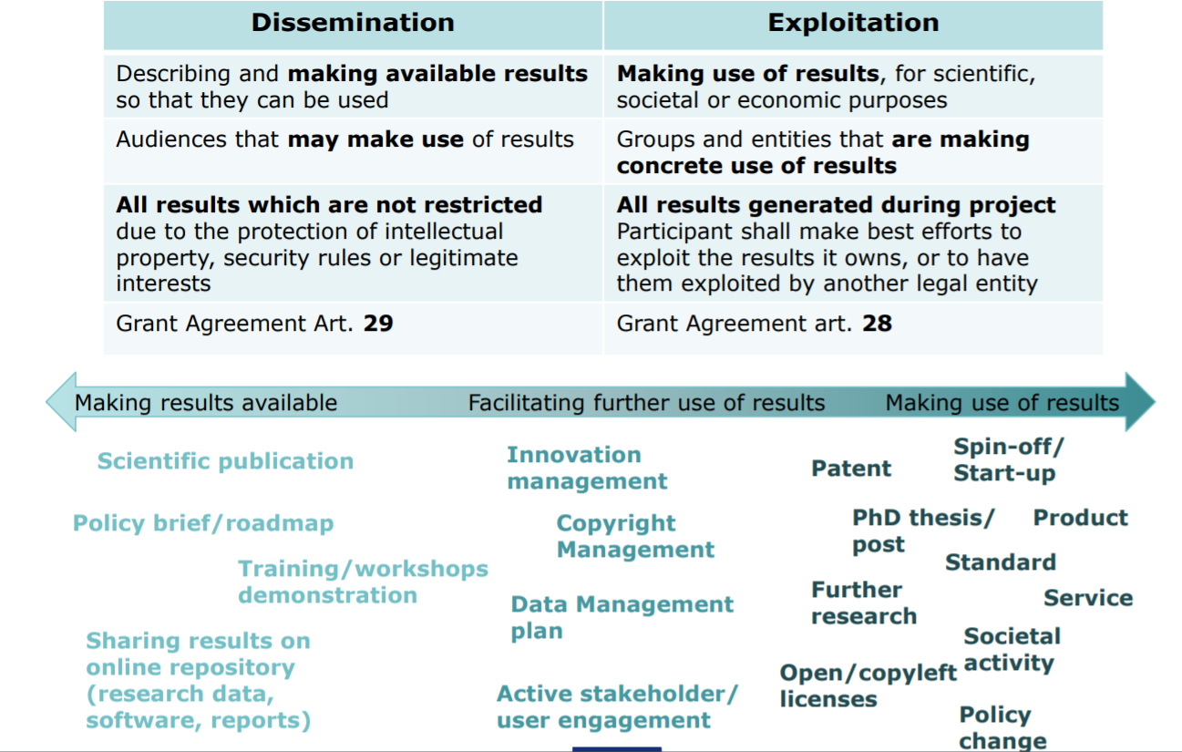
Dissemination & Exploitation of results: Admissibility Condition
At proposal stage: Draft plan for the dissemination and exploitation of project’s results
Communication activities for promoting the project and its findings
Ongoing activity-→strategy

Slide 20
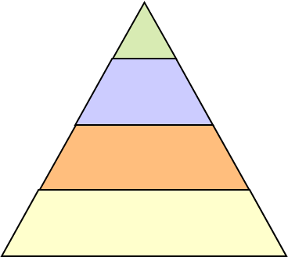
Impact – Target Groups & outcomes
The extent of the benefits for
Science
Technological progress
Environment
Society
Economy – EU Competitiveness
Acknowledge them separately
Consortium (publications, patents)
Scientific community & Industry
EU Competitiveness (businesses)
EU Society, economy

Slide 21
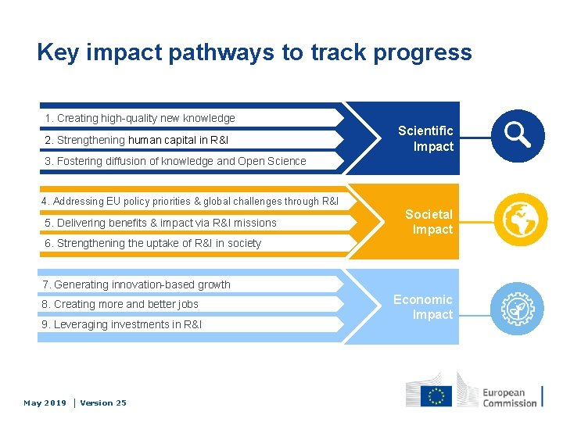
Key Impact Pathways

Slide 22
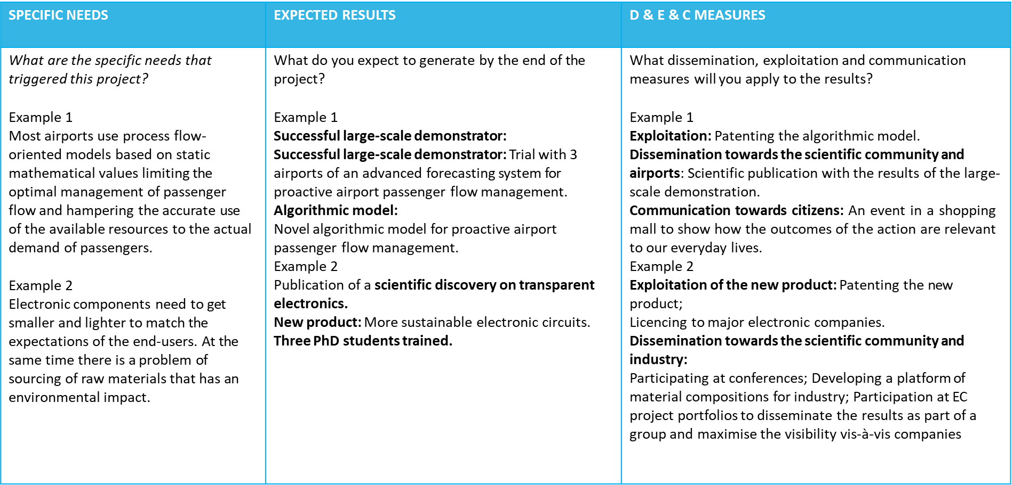
Proposal Impact: Needs, Results, Outcomes & Impact
Notes:
Αυτός είναι ο πίνακας που περιλαμβάνει τα συγκεκριμένα παραδείγματα και αναφέρει
Ανάγκες – αποτελέσματα- μέτρα προώθσης και επικοινωνίας- ομάδες στόχοι- αποτελέσματα και αντίκτυπος

Slide 23
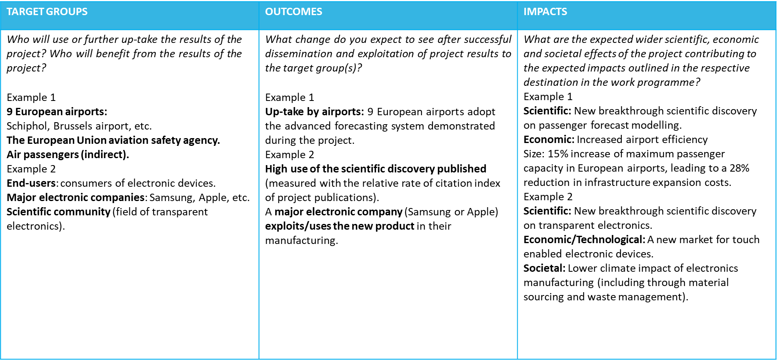
Horizon Europe: Proposal Impact
Notes:
Η παρουσίαση θα ειναι διαθέσιμη για να δείτε και τα συγκεκριμένα παραδειγματα- Παμε στο implementation

Slide 24
Implementation: Evaluation Criteria
Excellence
Clarity and pertinence of the project’s objectives, and the extent to which the proposed work is ambitious, and goes beyond the state-of-the-art.
Soundness of the proposed methodology, including the underlying concepts, models, assumptions, inter-disciplinary approaches, appropriate consideration of the gender dimension in research and innovation content, and the quality of open science practices including sharing and management of research outputs and engagement of citizens, civil society and end users where appropriate.
IMPACT
Credibility of the pathways to achieve the expected outcomes and impacts specified in the work programme, and the likely scale and significance of the contributions due to the project.
Suitability and quality of the measures to maximize expected outcomes and impacts, as set out in the dissemination and exploitation plan, including communication activities.
Quality and efficiency of the implementation
Quality and effectiveness of the work plan, assessment of risks, and appropriateness of the effort assigned to work packages, and the resources overall.
Capacity and role of each participant, and extent to which the consortium as a whole brings together the necessary expertise.
Notes:
Σε περίπτωση ισοβαθμίας των προτάσεων, θα γίνει επιλογή βάσει κριτηρίων όπως αριθμός γυναικών στην πρόταση και η γεωγραφική κάλυψη των δράσεων
Proposals that address call aspects identified in the topic description not otherwise covered by more
highly ranked proposals, will be considered to have the highest priority.
The proposals identified under 1), if any, will themselves be prioritised according to the scores they have been awarded for the criterion ‘Excellence’. When these scores are equal, priority will be based on scores for the criterion ‘Impact ’. NB: In the case of Innovation actions this prioritisation will be done first on the basis of the score for ‘Impact’, and then on that for ‘Excellence’.
If necessary, the gender balance among the personnel named in the proposal who will be primarily responsible for carrying out the research and/or innovation activities, and who are included in the researchers table of the proposal, will be used as a factor for prioritisation.
If necessary, any further prioritisation will be based on geographical diversity, defined as the number of EU Member states or Associated Countries represented in the proposal, not otherwise receiving funds from projects higher up the ranking list (and if equal in number, then by budget).
If a distinction still cannot be made, the panel may decide to further prioritise by considering other factors related to the objectives of the call, or to Horizon Europe in general. These may include, for example, enhancing the quality of the project portfolio through synergies between projects or, where relevant and feasible, involvement of SMEs. These factors will be documented in the panel report.

Slide 25
Implementation
3.1 Work Plan (work packages – deliverables)
3.2 Management structures, milestones and procedures
3.3 Consortium as a whole – complementarity of participants
Advising structures
Resources to be committed - tables

Slide 26
Key considerations
Consistency of work plan (should remind us of the objectives of the EXCELLENCE part and the IMPACT) and coherence (interrelation of WPs)
Complementarity of the participants (to reflect the scope of the call text)
Relevant and adequate management structures

Slide 27
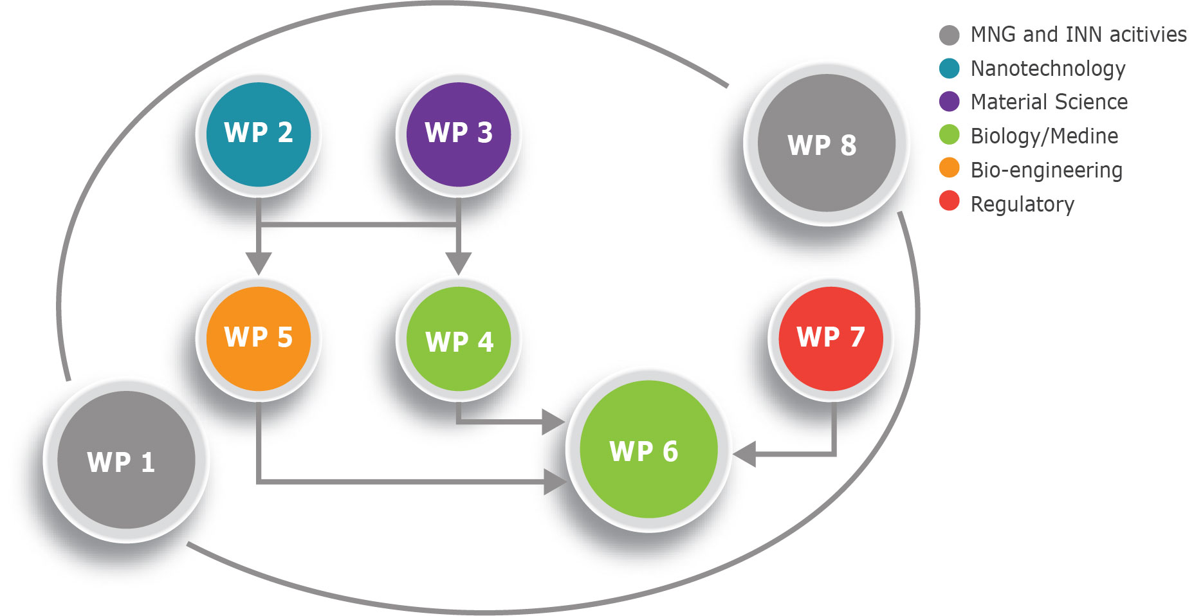
EXAMPLE: Presentation of the components showing how they inter-relate (Pert-chart or similar)

Slide 28
EXAMPLE: Timing of the different work packages and their components (Gantt chart or similar)

Slide 29
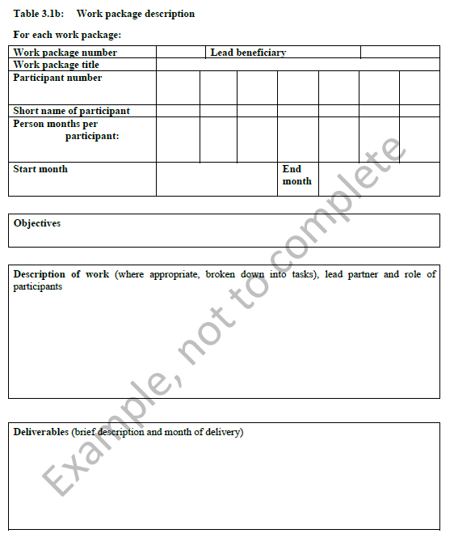
EXAMPLE: Work Package Description (Table 3.1b);

Slide 30
Contact Support Structures
Εθνικό Σημείο Επαφής
-----------------------------------------------------------------------------
Guidance on choosing relevant Horizon Europe topics and types of action
Advice on administrative procedures and contractual issues
Pre screening of proposal
Assistance in partner search

Slide 31
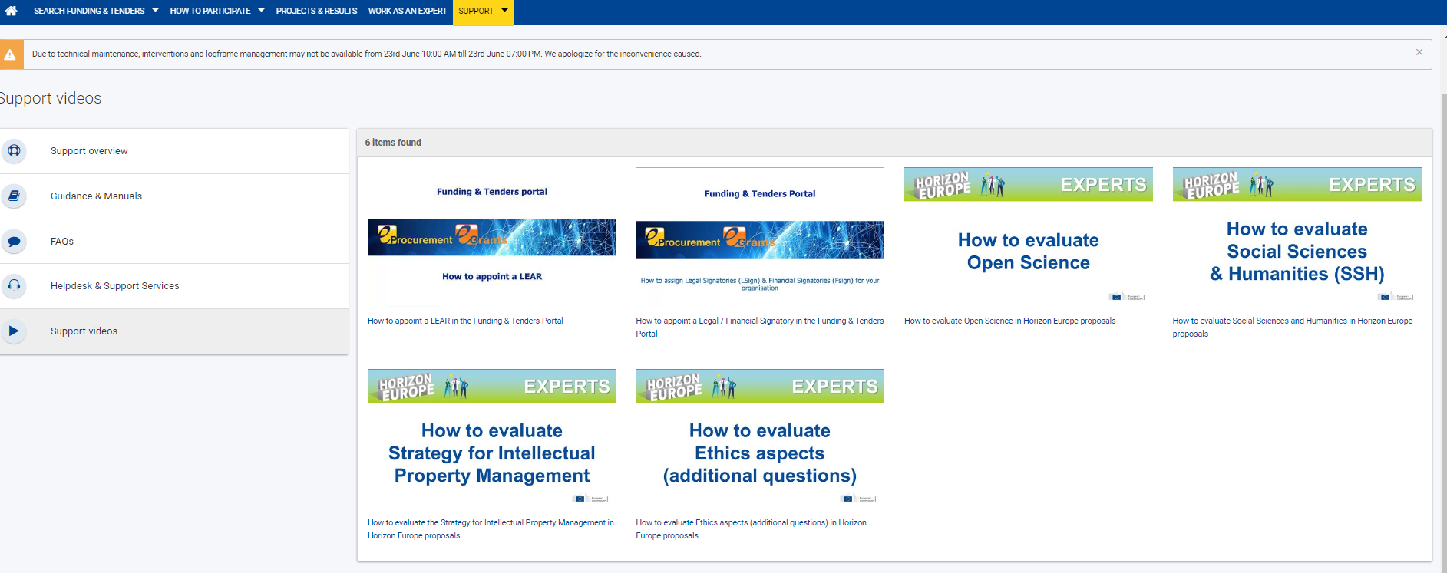
More information
https://ec.europa.eu/info/funding-tenders/opportunities/portal/screen/support/videos

Slide 32

Final remarks
It’s not sufficient
to have an excellent idea …
But it is important to organize the proposal preparation in an excellent way!!!
What is not there is not evaluated!!!

Slide 33

Σας ευχαριστώ πολύ!
Βασιλική Καλοδήμου
vkalodimou@praxinetwork.gr
Visit: www.horizoneurope.gr

